Slide 1

Air Pollution and Respiratory Diseases
GROUP MEMBERS: Jessica E, Ariana G, Loraine G, Paul S, Deborah D

Slide 2
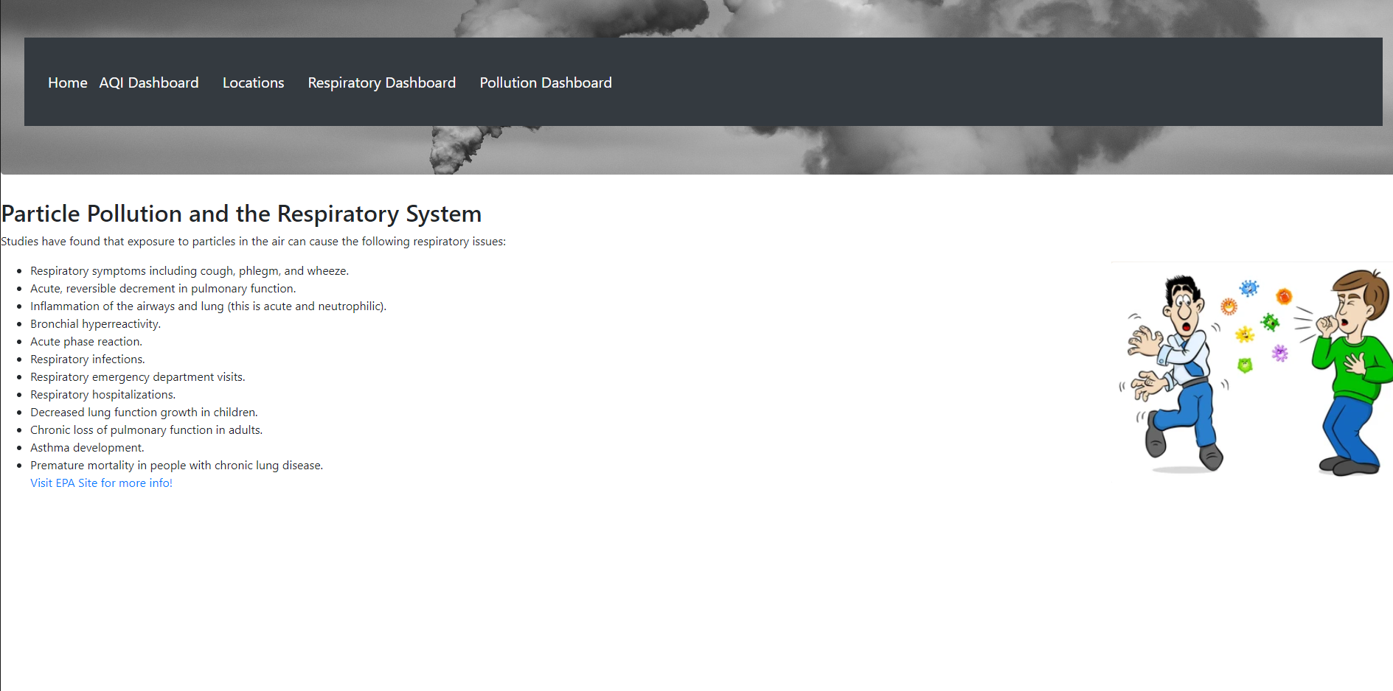
Home Page:
Gives a list of respiratory illnesses and diseases that can be caused by air pollution.
Navigation Bar showcases different interactive charts.

Slide 3
Process:
Gather historical data on respiratory deaths, population, and Air Quality metrics for the years 2020-2022
Store the data in a PostgreSQL database.
All cleaning, joining, and aggregation occurred within the database
Extracted the data and loaded it into JavaScript files in csv format.
Created interactive dashboards to answer the following questions:

Slide 4
Questions:
How many times per year does a state suffer from poor air quality?
Where are the air quality stations located?
How many people die each year in the US from a respiratory illness or disease?
What was the highest (poorest) Air Quality Index (AQI) and death count for each state in any given year?
The dashboards will attempt to answer these questions.

Slide 5
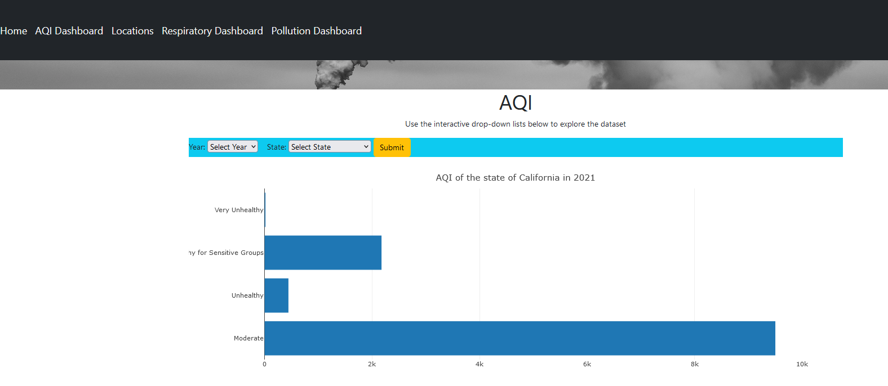
How many times per year does a state suffer from poor air quality?
The AQI Dashboard Menu Option redirects to the interactive plotly map that allows a user to select a year and state to discover how many hours in that year the air quality fell into the various AQI index categories.

Slide 6
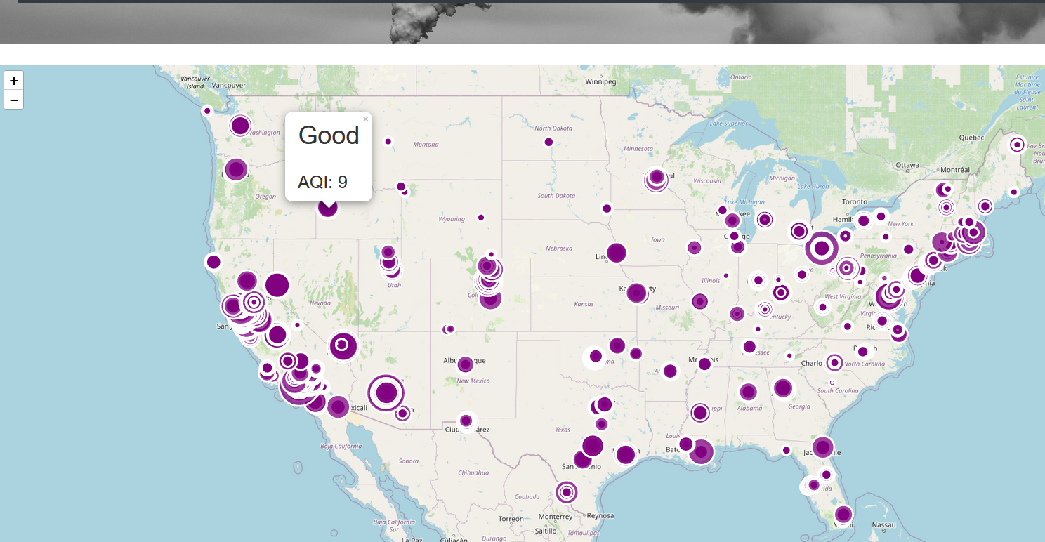
Where are the air quality stations located?
The Location menu item will take the user to a map of U.S., displaying where air quality measurements are taken and what the AQI is for that area.
Notice the measurement equipment locations leave very large gaps in data collection.

Slide 7
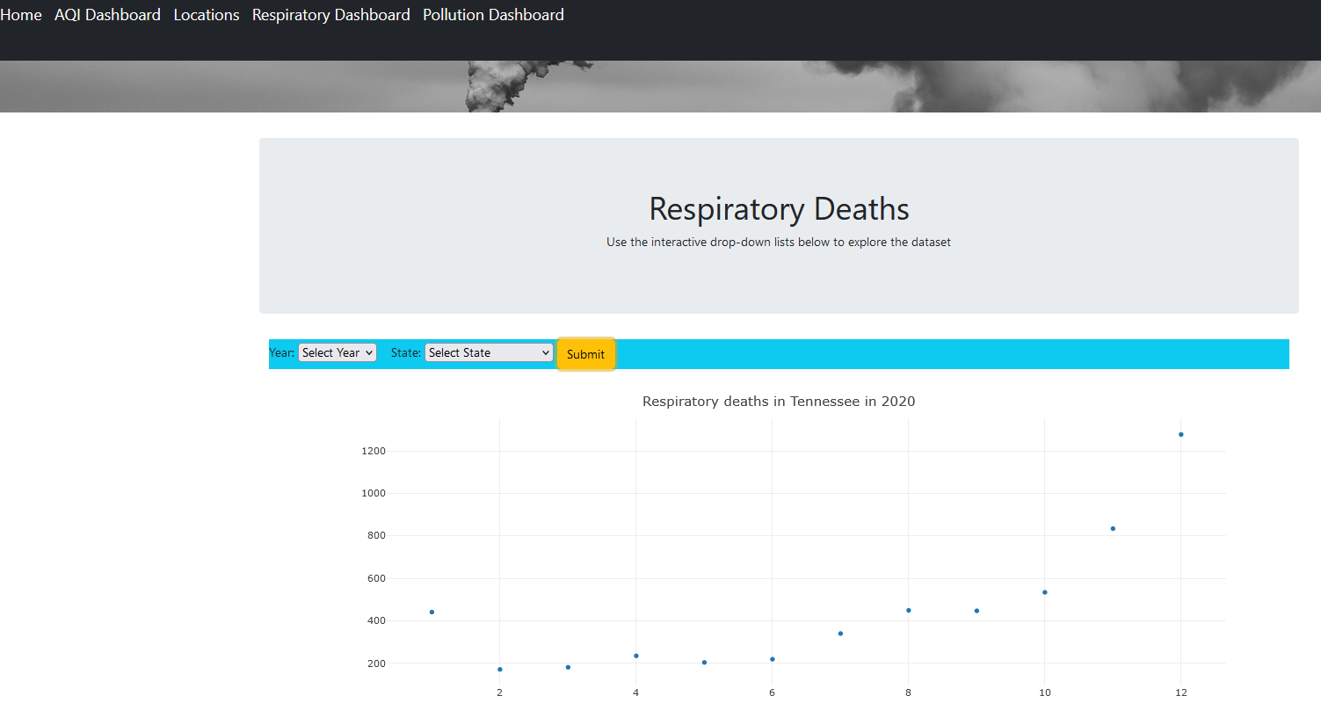
How many people die each year in the US from a respiratory illness or disease?
The Respiratory Dashboard Menu option redirects to a Plotly chart that displays the count of all respiratory deaths in a selected year within a selected state from 2020 to 2022.
No noticeable trends could be determined with the respiratory death data.

Slide 8
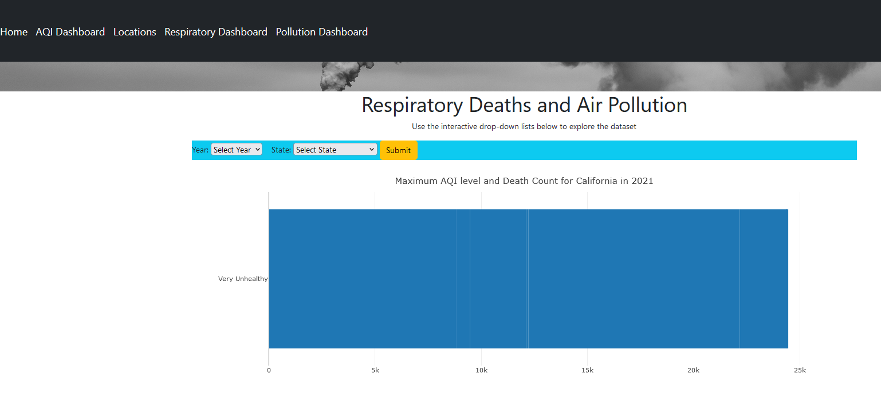
What was the highest (poorest) Air Quality Index (AQI) and death count for each state in any given year?
The Pollution Dashboard Menu option redirects to an interactive Plotly chart that displays the highest level of air quality and respiratory death counts for the year and state from 2020 to 2022
Note – higher death count could easily be attributed to higher population count. No trends noted here, either.

Slide 9
Conclusion:
Accept the null hypothesis
Population count plays a heavy role in the death count of a state, extra calculations could be put in (with more time) to account for the percentage of deaths instead of the counts.
The location of AQI Measurement stations leave wide gaps between locations. This could cause the states without measurement equipment to have lower AQI values recorded, skewing the datasets.
We could find no discernable correlation between states with worse air quality and respiratory death count in that state.
The dashboards will attempt to answer these questions.

Slide 10
SOURCES:
CDC: https://data.cdc.gov/NCHS/Monthly-Provisional-Counts-of-Deaths-by-Select-Cau/9dzk-mvmi/data
Open Weather: https://openweathermap.org/api/air-pollution
EPA: https://www.epa.gov/clean-air-act-overview/air-pollution-current-and-future-challenges

